Slide 1
Non-Deterministic Finite Automata
Automata Theory
Ege University
Department of Computer Engineering
2010-2011 Fall

Slide 2
“Non-Determinism
In “Non-deterministic” models, finding
out a path is not only dependent on
the input given. The model has to
decide. (Human factor or artificial
intelligence).
4
b
3
....
???
b
5

Slide 3
Definition
A non-deterministic finite automata (NFA) is a collection of three things:
  A set of states one of which is a start state, and one or more of which are finite states.
  An input alphabet.
  Transitions from one state to another. Null ( Λ ) transition is not allowed.

Slide 4
Theorem
For every FA, we can build a NFA that accepts the same language.
Example:
  The language of all words that contain either triple a or triple b).
  NFA and FA are given in the following slides.

Slide 5
Example NFA
a,b
a
a
+
a,b
a
-
a,b
b
+
b
b

Slide 6
DFA for the Same Language
a
a
a
a
a,b
b
-
b
a
+
b
b
b

Slide 7
Question
Alphabet={0,1} is given. L is the language of all words that end with 01. Build FA and NFA models for L.

Slide 8
Labyrinth Example
Is it possible to exit in six steps?
-
1
2
3
4
5
6
7
8
9
+

Slide 9
Labyrinth Example
a
a
1
2
+
......
a
a
a
a
a
a
Is the string aaaaaa accepted
by this model?
Can you write a RE?
-
3
a
a
a
4
.......
a

Slide 10
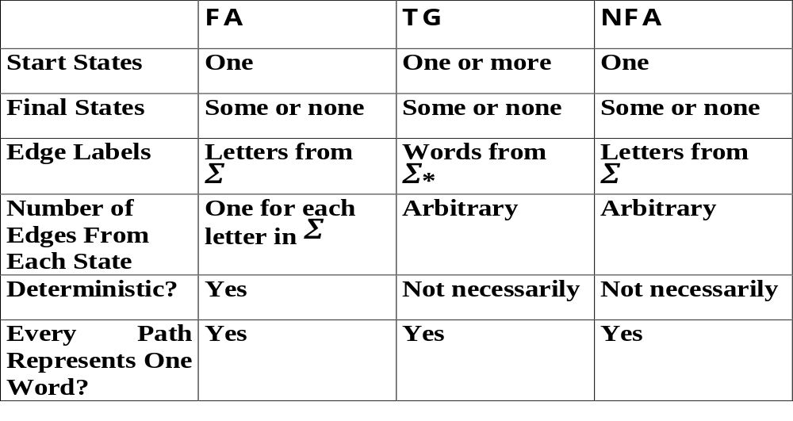
Comparison for DFA, TG and NFA

Slide 11
Theorem
For every NFA there is some FA that exactly accepts the same language.
There is a method for converting a NFA to a FA. A concrete example will be given in the class.

